Slide 1
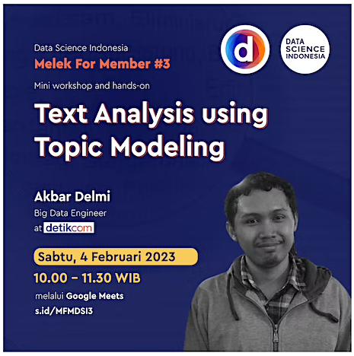
Text Analysis using Topic Modeling

Slide 2
Perkenalan
Educational Background
Bachelor of Mathematics, Universitas Indonesia 2012-2017
Working Experience
Backend Engineer at Dattabot (2016-2017)
Data Analyst at Home Credit Indonesia (2018)
Senior Data Engineer at Detik.com (2018-2023)

Slide 3
Pembukaan
Introduction to Topic Modelling
Topic Modelling Application
Document Representation
Latent Dirichlet Allocation
LDA Intuition and Idea
LDA Process
Tools and Framework

Slide 4

Introduction to Topic Modelling
Topic Modelling is a type of statistical model for discovering the abstract "topics" that occur in a collection of documents.
Topic Modelling aims to grouping certains of article by the similarity of their “topics” without knowing the label of the “topics”
Topic Modelling itself can be classified as unsupervised method or commonly as clustering method but for documents or articles

Slide 5
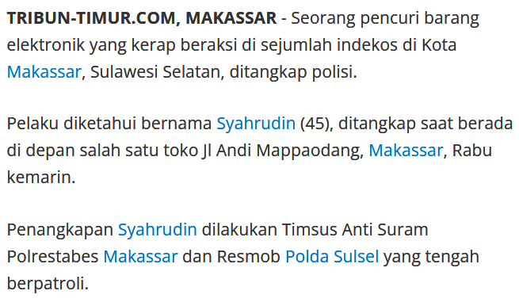
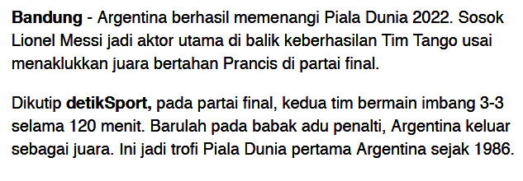
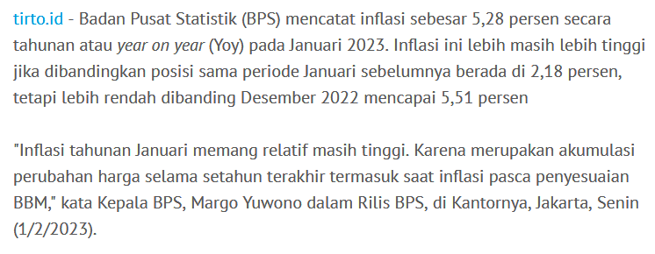
What is Topics?

Slide 6
Joko Widodo
pemerintahan
Luhut Binsar Pandjaitan
Anies Baswedan
pemilu
koalisi
Messi
Ronaldo
Liga Inggris
Inter Milan
gol
pinalti
Iphone
ChatGPT
prosesor
deep learning
artificial intelligence
Javascript
polisi
tersangka
begal
pasal
korban
penipuan
Marvel
Blackpink
Last of Us
Isyana
konser
syuting
resesi
inflasi
neraca dagang
investasi
suku bunga
Bank Indonesia

Slide 7
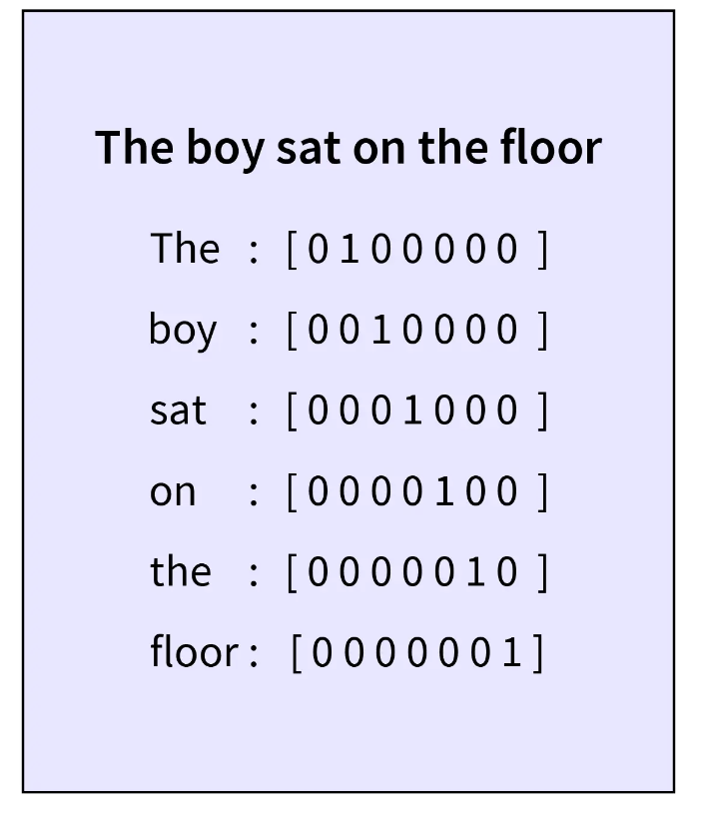
Text Representation
Documents or texts is not a quantitative value, so it must convert to value to be calculated or measured by computer
Several method to quantify the text is by using frequency of words or probabilistic of the word itself

Slide 8
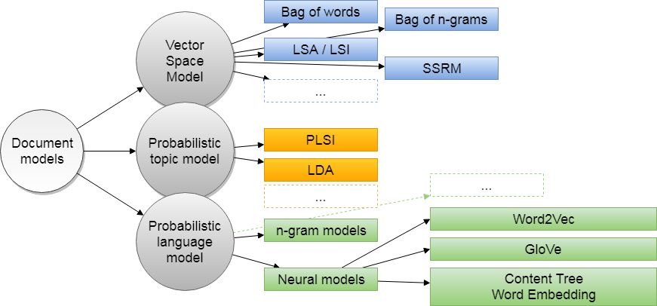

Slide 9

Topics Modelling Intuition
Idea :
Topics is an label of document which contains several consistent pattern of words
Document are mixtures of topics and topic is a probability distribution over words
Aim :
Discover pattern of word use and and connects documents that exhibit similar pattern

Slide 10
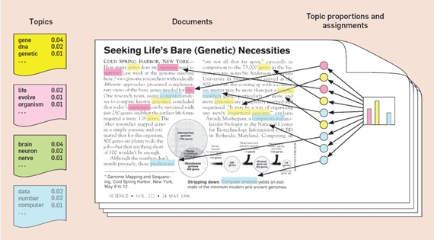

Slide 11
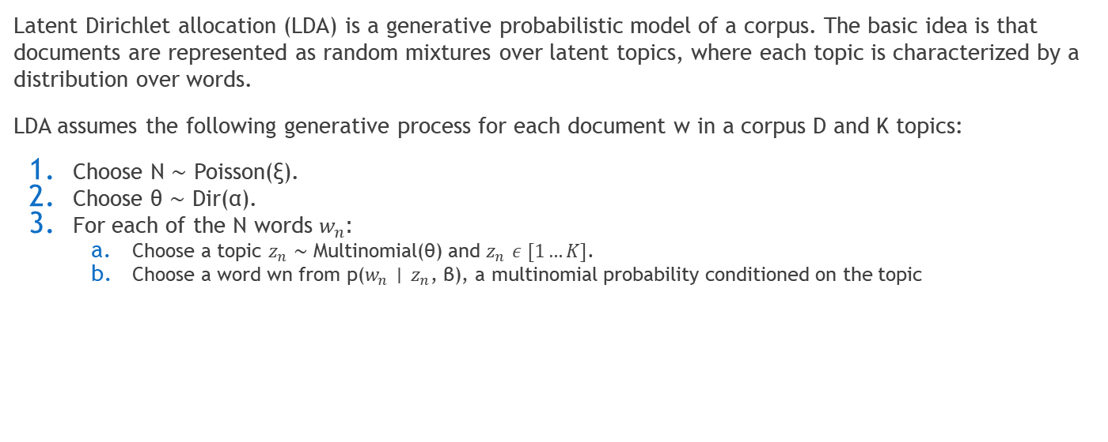
Latent Dirichlet Allocation (LDA)

Slide 12
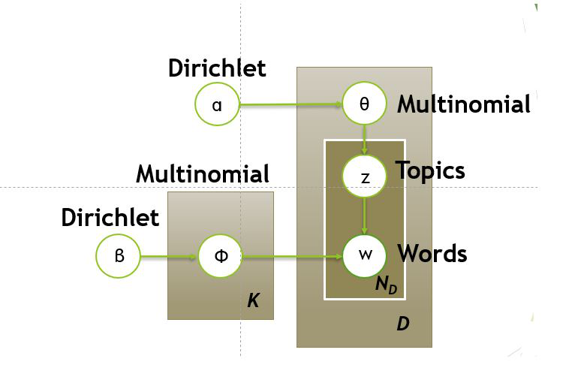
LDA
Notes:
Secara acak memilih sebuah topik dari distribusi topik pada langkah pertama.
Secara acak memilih sebuah kata dari distribusi kosakata yang sesuai.

Slide 13
LDA Formula
Let θ as is the topic distribution for document i,
α is the parameter of the Dirichlet prior on the per-document topic distributions,
β is the parameter of the Dirichlet prior on the per-topic word distribution,
p(word w with topic t) = p(topic t | document d) * p(word w | topic t)

Slide 14
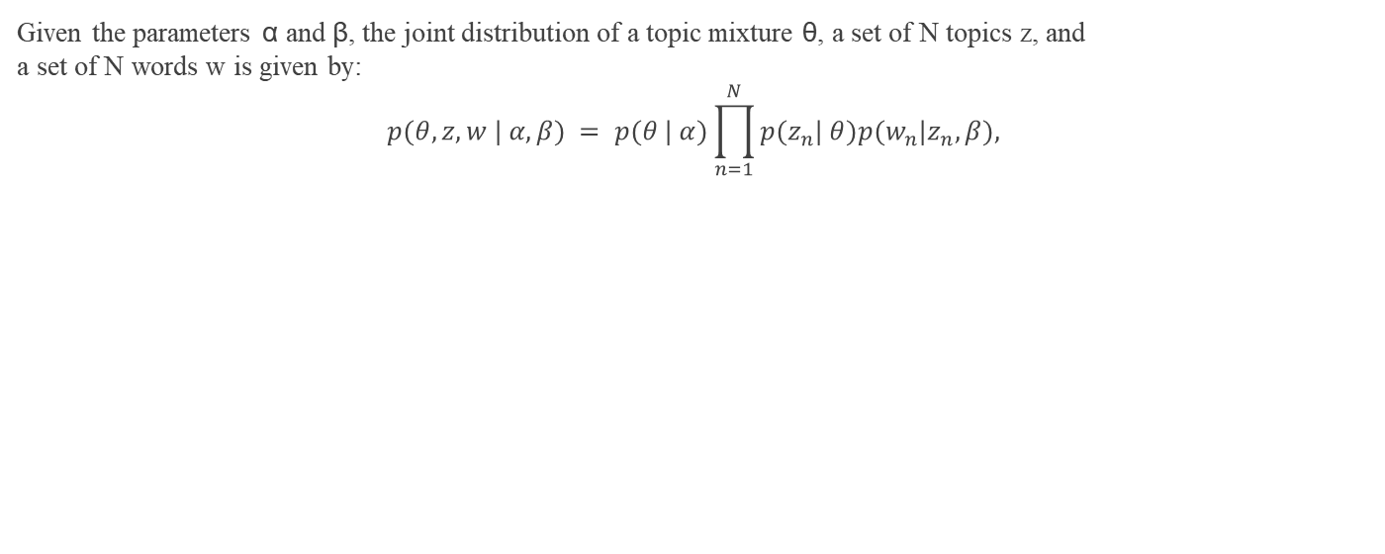
LDA

Slide 15
LDA
Assume there are two topics which every word is consisted for each topics
words | P(words | topic =1) | P(words | topic =2)
Heart | 0.2 | 0
Love | 0.2 | 0
Soul | 0.2 | 0
Tears | 0.2 | 0
Joy | 0.2 | 0
Scientific | 0 | 0.2
Knowledge | 0 | 0.2
Work | 0 | 0.2
Research | 0 | 0.2
Mathematics | 0 | 0.2

Slide 16
LDA
Words in Document | {P(topic=1), P(topic=2)}
MATHEMATICS KNOWLEDGE RESEARCH WORK MATHEMATICS RESEARCH WORK SCIENTIFIC MATHEMATICS WORK | {0,1}
SCIENTIFIC KNOWLEDGE MATHEMATICS SCIENTIFIC HEART LOVE TEARS KNOWLEDGE HEART | {0.25, 0.75}
MATHEMATICS HEART RESEARCH LOVE MATHEMATICS WORK TEARS SOUL KNOWLEDGE HEART | {0.5, 0.5}
WORK JOY SOUL TEARS MATHEMATICS TEARS LOVE LOVE LOVE SOUL | {0.75, 0.25}
TEARS LOVE JOY SOUL LOVE TEARS SOUL SOUL TEARS JOY | {1,0}

Slide 17
Tools and Framework
Python 3.6+
Pandas
Sklearn
Seaborn/Matplotlib
Gensim
PyLDAvis (required <= pandas 1.2)

Slide 18
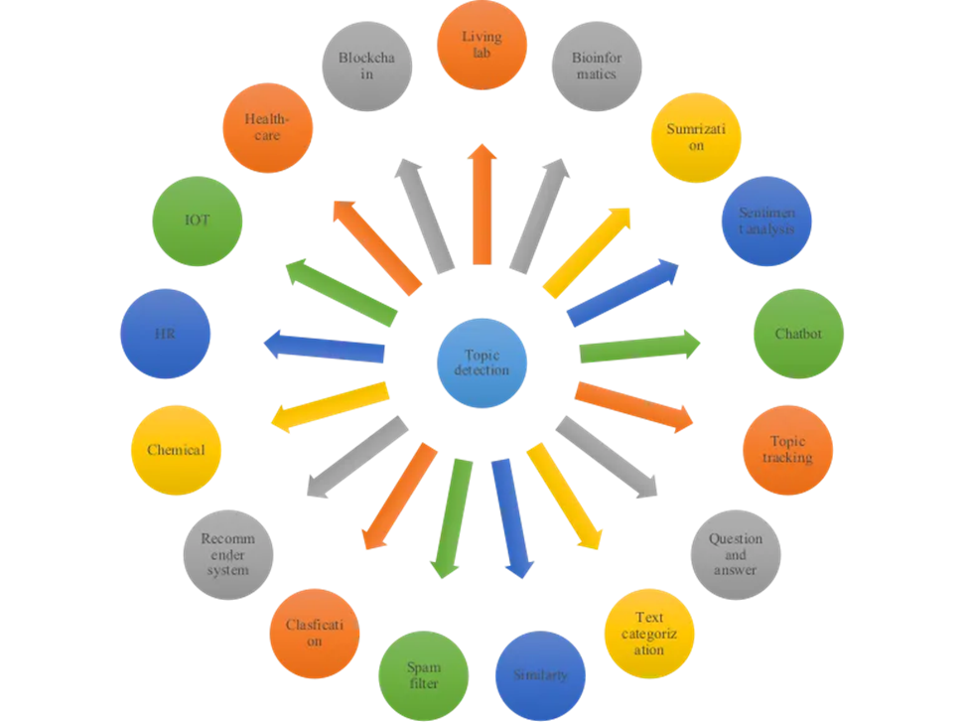
Implementation

Slide 19
Reference
https://www.geeksforgeeks.org/latent-dirichlet-allocation/
https://socs.binus.ac.id/2018/11/29/latent-dirichlet-allocation-lda/
https://towardsdatascience.com/latent-dirichlet-allocation-lda-9d1cd064ffa2
https://www.jmlr.org/papers/volume3/blei03a/blei03a.pdf

